Slide 1


*
*
*
Troubleshooting Basics!
Solutions for a modern era…
*
whhender
June 2020

Slide 2
*
Agenda
*
*
*
Kinds of Issues
Break/Fix
How to Start Thinking About An Issue
Where to Go When You Don’t Know
Testing a Solution
Troubleshooting with your Customer
When to Involve the Product Teams
To Whom You Can Reach Out
Advisory
How to Work an Advisory Case
Where We can Get Help
How to Involve Others
*
*

Slide 3
*
*
*
*
*
*
*
*
*
*
*
All of this is on the wiki!
aka.ms/bigdata
Search:
Technical Troubleshooting
*
*
*
*
*
*
*
*
*
*
*
*
*
*
*
*
*
*
*
*

Slide 4
Advisory Issue
An advisory issue is an issue that covers architecture, best practices, usage, and development questions not related to any error or problem with the product.
For Example…
What’s the difference between Azure Data Lake Gen 1 and Gen 2?
I’m new to Azure and need help developing a pipeline that does X.
I’ve developed an architecture that does X and need MSFT to review.

Slide 5
Break/Fix Issue
A break/fix issue is an issue where the product is not behaving as expected and is throwing an error, not operating as anticipated, or producing unexpected results.
For Example…
When running my script, I am getting a 403 Forbidden error…
The portal should do X, but instead I am seeing Y behavior.
My job used to work, but is now failing with this error…

Slide 6
How to Think Through a Problem...
Define the Problem
Summarize/Describe the Problem for Understanding
Create a Hypothesis for Root Cause
Test Hypothesis
Verify Root Cause

Slide 7

*
*
*
1. Define the Problem
Who is affected by the problem?
What are the symptoms?
When does the problem occur?
Where does the problem occur? (What components are involved?)
Why is this important to solve the problem?
(Are there workarounds?)

Slide 8
For Example…
Description:
“I am getting an access error trying to access my data through the portal…”
Who
- Do all users see this error, a subset, or just you?
What
- What is the full error message?
When
Do you see this error every time you attempt to access the data?
When was the last time you saw this error?
Did this work in the past? When did it stop?
Where
Do you only see this error through the portal? Have you tried with a script or another tool?
Do you see the same error if you use InPrivate browsing?
Why
- What do you need to access the data for? What is this error preventing you from doing?

Slide 9
*
*
*
2. Summarize/Describe
Once you have answers to the 5 W Questions, use the answers to create a brief summary to ensure that you understand the problem.
This will make sure you’re addressing the right problem the FIRST TIME and is an important reference for later troubleshooting steps.
*
Write a Statement
Draw It Out
*
*

Slide 10
Description:
“I am getting an access error trying to access my data through the portal…”
Who
- Only one user is seeing this error.
What
- “You do not have access. An authorization failure occurred. This request is not authorized to perform this operation. RequestId:43cca8bf-f01e-0027-7315-431f99000000”
When
Yes, I see this error every time I attempt to access the data through the portal. Last time: Time:2020-06-15T13:04:15.8727806Z
This used to work. Error started in Mid-March.
Where
Only see error through the portal. ADF and Databricks work fine.
I see the same error using InPrivate Browsing
Why
- I manage the data through the portal. It is easier to click through than list the data using a script.

Slide 11
*
*
Write a Statement…
*
Using your problem definition questions, write out a brief statement that covers what the issue IS and what it IS NOT
“Since mid-March, one user is having consistent trouble attempting to access the data through the portal. Accessing the data through a script works just fine, and other users are also able to access the data as expected.”

Slide 12
*
*
Draw it out…
*
What Should Be
Happening
*
Is Anything in the Way?
Where is the data coming from?
What is between them?
Where is the data going to?
*
What’s Actually Happening

Slide 13
*
*
Draw it out…
*
User able to see data in portal
*
Firewall on Azure Net
Data Permissions
User on their laptop at home.
User Network, Company VPN
Data stored on Azure
*
Access Error Message
Azure VNet
Script running from Databricks

Slide 14
*
*
*
3. Hypothesize
To start hypothesizing about the root cause, think about COULD BE affected, but IS NOT
Then compare the COULD BE but IS NOT scenario with the COULD BE and IS.
--------------
Also think about WHEN the issue occurred.
Were any changes made between when it was working and when it began failing?

Slide 15
Description:
“I am getting an access error trying to access my data through the portal…”
COULD BE and IS
Single User Accessing Data Through Portal
COULD BE but IS NOT
Other Users Accessing Data Through Portal
COULD BE but IS NOT
Databricks Script Accessing Data
Differences Between IS and IS NOT
--------------
- Location of Access (Different Machines)
- User Authenticating
- Different Command Used to Access Data
- Different Networks

Slide 16

*
Running out of ideas?
Just remember…
that in this role, success is knowing where to find the answer, and not necessarily always having the answer right off the top of your head.
Don’t be nervous! This is part of our strength! Our cloud products change every day, so we rely on teamwork and documentation to get the solve our cases.
Gone are the days of a handbook of known errors. Welcome to the new era of troubleshooting on the fly!
So, let’s find…
…where to go when you don’t know!

Slide 17
*
*
*
Read Case
Description/Error Message
Check TSGS
Check Documentation
Check ASC
*
*
*
*
Draw/Write
It Out
Check Internal Logs
Check Triage
Call/Email
Check the
Internet
*
*
List Everything You Know
*
*
*
Reproduce
In Your Environment
*
SME or TA
Review
Relevant, specific logs.
Use AVA
ICM
*
*
Ask Specific Questions!
Thorough Case Notes
One issue per ICM.
*

Slide 18
*
*
*
*
Read Case
Description/Error Message
*
*
*
*
*
*
*
1. Read the FULL description and error message.
*
*
*
*
*
2. Validate against current information.
*
*
*
*
*
3. Verify against environment.
*
*
*
*
*
4. Verify against documentation.
*
*
*
*
*

Slide 19
If your customer says…
Read Case
Description/Error Message
…their job is failing with the ‘same’ error.
…that they ‘didn’t change anything.’
…their job is failing with a ‘different’ error.
…the file exists.
…they have permissions.
…the data is in the correct format.
Trust, but verify!

Slide 20

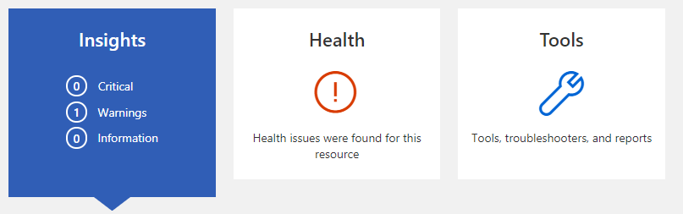
Azure Support Center
Check ASC
*
//azuresupportcenter.msftcloudes.com
*
1. Use ASC to search documentation and old cases.
2. Use ASC to check current health alerts.

Slide 21
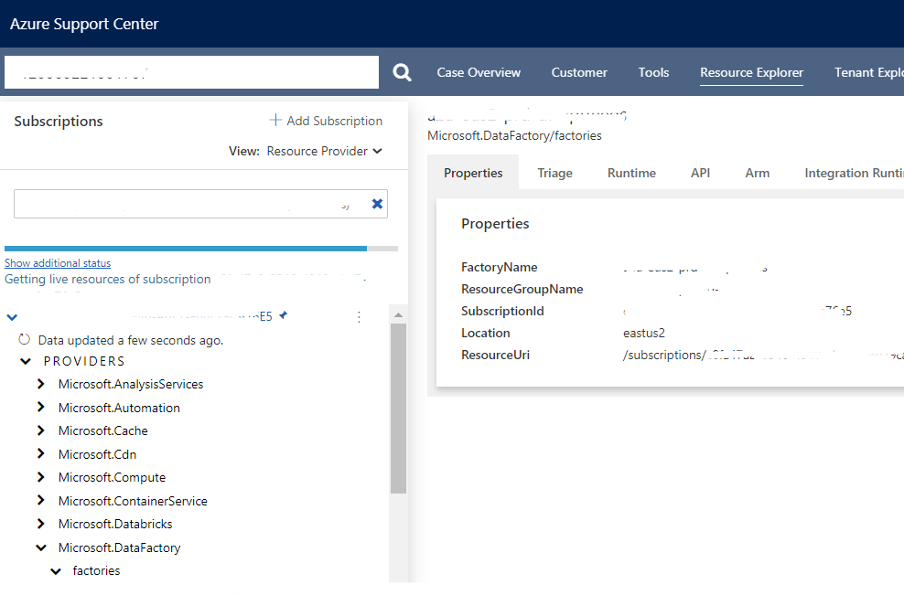
3. Use ASC to troubleshoot your cases.
Most products have tools in ASC to help you find logs, diagnose issues, and take next steps.
Check ASC even for products you don’t support to see what kind of tools are at your disposal.
*
*
Check product wikis for any available guides on how to use their ASC tools!
*

Slide 22
Troubleshooting Guides
Check TSGs
Most products have Troubleshooting Guides available to provide steps to tackle known/reoccurring problems.
Remember!
Find these guides by searching TSG or Troubleshooting on the wiki.
TSGs are usually written for YOU, not your customer. So if you need to provide your customer steps, modify/rewrite the steps to make sure they are relevant and customer focused.
If you can’t find them, reach out to a peer, SME, TA, or to a product team member to ask if they are available and where.

Slide 23
Azure Documentation
Check Documentation
Always check our Azure Public Documentation!
This documentation covers all the basics of how to use our tools and is completely available to the customer.
To find Azure Documentation go to:
docs.microsoft.com
and select ‘Azure’
Link any of these documentation pages to your customer as well!
Remember!
For solutions involving multiple products, remember to check documentation for all products to make sure you understand all settings and cover any potential issues.
And always recheck!

Slide 24
*
Internal Logs
*
Check Internal Logs
Internal logs are product-specific, as is level of access and what kinds of information you can find in these logs.
Check your product training/wiki to find out how what kinds of logs you can access for your product and how to use them.
If you have questions reach out to peers, SMEs, and TAs.
And if the product team uses logs that you didn’t know about, ask them if you have access and how to use them!
Remember!
Internal logs are for internal use and shouldn’t be shared directly with your customer unless specifically mandated.
Share what the logs mean, not the logs themselves!

Slide 25
*
The Internet
Check the
Internet
*
Search any error messages or customer issues using your favorite internet search engine.
Tips to Find Azure Information on The Internet:
Avoid Acronyms and Abbreviations like ADF or ADLS. Instead use full names.
Put double quotes around full error messages to search for that text specifically.
Check the date on solutions! Azure changes quickly, so old problems might have already been resolved.
*
Remember!
You can provide your customer information you find on the internet but use discretion. We want our customers to be confident in Microsoft Support, so test solutions first and use Microsoft official links where possible.

Slide 26
Triage Calls and Emails
Check Triage
Call/Email
Many teams and products have weekly or even daily triage calls, chats or email threads to review current cases!
Check for a review of your case or bring your case to a call to have it reviewed for next steps.
These are usually run by SMEs, Escalation Engineers, or the Product Team.
Check with your TA, SME, or your product’s training documentation to see when your triage call is!
Remember!
Some issues look similar, and Azure changes quickly. Before providing a solution to your customer, make sure the solution and steps are relevant to your customer’s situation.

Slide 27
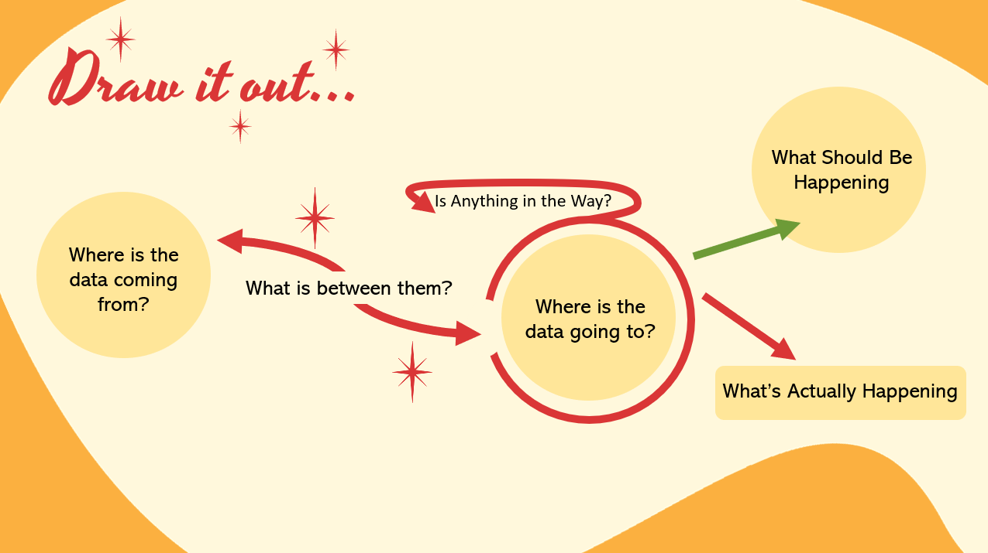
Draw/Write
It Out
List Everything You Know

Slide 28
Reproducing the Error
Reproduce
In Your Environment
You should have an azure environment you can use as a sandbox to reproduce customer errors!
How to Repro…
Why repro?
When is a good time to repro? What about example data?
Break issue/scenario down into only the pieces that are failing or causing a failure and recreate that part.
If data error, approximate the kind of data that would cause the failure, or obtain sample data from customer.
If you cannot repro, consider the differences between your environment and the customer environment. That may be where the issue is!
Why Repro?
Respect Customer’s Time
Better Issue/Mitigation Understanding
You can gather your own logs rather than relying on the customer’s logs.
Issue may only occur in customer environment.
Make sure the sample data contains no passwords or identifiable information to protect customer security.

Slide 29

*
Who is AVA?
*
Use AVA
Ask Specific Questions!
Ava is a support chat bot used by most product groups on product team channels to help you find help!
Use Ava on enabled Teams channels by typing: @Ava
You can also use Ava to ask for help on a case. Type:
@Ava 120050521002456 - <your question>
Different Channels have different Ava commands enabled use @Ava help to learn more!
Documentation: https://azureava.microsoft.com
Remember!
Ava is pinging relevant team members like SMEs, and product team members to help with your case.
Don’t just add your case number!
For better, faster help, ask a specific question!

Slide 30
When do you need a review?
SME or TA
Review
Thorough Case Notes
Feeling stuck on a case?
Is a customer getting out of hand?
Has communication with the product group gone awry?
Request a case review!
Remember!
Your TA or Escalation Engineer is following all these same troubleshooting steps! If you’ve done them, add it to your case notes or we’re going to ask about it. The only difference between our processes is experience.
Your TAs and Escalation Engineers are here to help you with tough cases when you don’t know where to go next.
However:
Please first add thorough case notes that detail the situation as you understand it and ask specific questions if you have them. Our review will be better this way.

Slide 31
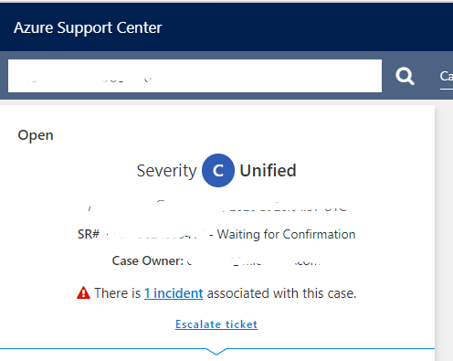
Involving the Product Team
Relevant, specific logs.
ICM
One issue per ICM.
When there is an issue occurring with the product, you can create an ICM – essentially a case with the product team.
You can do this through ASC by clicking ‘Escalate Ticket’
Remember!
We’re here so that the product team can focus on the product! Customer support is our role.
There is a reason this is the last step in our flow.
Provide all relevant, specific logs that point out the issue.

Slide 32
Involving the Product Team
Relevant, specific logs.
ICM
*
One issue per ICM.
When there is an issue occurring with the product, you can create an ICM – essentially a case with the product team.
You can do this through ASC by clicking ‘Escalate Ticket’
*
The product team isn’t troubleshooting for you!
Provide them as much, specific information as possible to outline the product issue you are seeing.
*
*
Remember!
We’re here so that the product team can focus on the product! Customer support is our role.
There is a reason this is the last step in our flow.
Provide all relevant, specific logs that point out the issue.

Slide 33
Involving the Product Team
Relevant, specific logs.
ICM
*
One issue per ICM.
When there is an issue occurring with the product, you can create an ICM – essentially a case with the product team.
You can do this through ASC by clicking ‘Escalate Ticket’
*
For questions about a product, reach out to SME or Product Teams Channel.
ICMs are not for questions.
*
*
Remember!
We’re here so that the product team can focus on the product! Customer support is our role.
There is a reason this is the last step in our flow.
Provide all relevant, specific logs that point out the issue.

Slide 34
*
*
*
Read Case
Description/Error Message
Check TSGS
Check Documentation
Check ASC
*
*
*
*
Draw/Write
It Out
Check Internal Logs
Check Triage
Call/Email
Check the
Internet
*
*
List Everything You Know
*
*
*
Reproduce
In Your Environment
*
SME or TA
Review
Relevant, specific logs.
Use AVA
ICM
*
*
Ask Specific Questions!
Thorough Case Notes
One issue per ICM.
*

Slide 35
*
*
*
Read Case
Description/Error Message
Check TSGS
Check Documentation
Check ASC
*
*
*
*
*
*
Ask questions anytime! Ask for help anytime!
Peers, SMEs, TAs, Escalation Engineers!
*
Draw/Write
It Out
Check Internal Logs
*
Check Triage
Call/Email
Check the
Internet
*
*
List Everything You Know
*
*
*
Reproduce
In Your Environment
*
SME or TA
Review
Relevant, specific logs.
Use AVA
ICM
*
*
Ask Specific Questions!
Thorough Case Notes
One issue per ICM.
*

Slide 36
What’s your question?
Technical
-or- Troubleshooting
Case Management
-or- Customer Handling
Technical Advisor (TA)
Subject Matter Expert (SME)
Peer
Triage Meeting Ava
Product Group Teams Chat
Technical Advisor (TA)
Technical Account Manager (TAM)
Escalation Engineer
Manager

Slide 37
Hypothesize
Description:
“I am getting an access error trying to access my data through the portal…”
Differences Between IS and IS NOT
--------------
- Location of Access (Different Machines)
- User Authenticating
- Different Command Used to Access Data
- Different Networks
Possible Causes
--------------
Firewall blocking other locations
Incorrect User Permissions Applied
Network Latency/Timeout
Bug with command in Azure Portal

Slide 38
*
How to Gather Data and Test Potential Solutions
How critical is the information? (Do you need to know something to create a hypothesis?)
How likely is it that the potential cause is the REAL cause?
How easy are the steps to execute? (Time and skill required.)
How dangerous is it? (Do these steps put their system at any risk?)
Answer these questions for each piece of data or potential solution. Then rank them based on your answers!

Slide 39
*
How do you know which root cause is most likely?
Compare your differences between IS and IS NOT for each potential solution.
The solutions that best explains ALL is and is not scenarios is the most likely.
Possible Causes
--------------
IS
IS NOT
------------
------------
Firewall blocking other locations
Incorrect User Permissions Applied
Single user unable to access data from personal machine.
Consistent Problem
Script Accessing Data
All Users
Intermittent
Network Latency/Timeout
Bug with command in Azure Portal
Differences Between IS and IS NOT
--------------
- User Authenticating
- Location of Access
- Different Command Used to Access Data
- Different Networks

Slide 40
*
How easy are the steps?
What information do you need to gather or settings to change to test solution?
How hard is it to gather the information or perform the step?
Possible Causes
--------------
Firewall blocking other locations
Check Firewall Settings In Portal
Add User IP Address
Incorrect User Permissions Applied
Check User Permissions in portal. Compare with successful user.
Check what permissions script is using to authenticate.
Network Latency/Timeout
Network Trace
Bug with command in Azure Portal
What command is used in script vs portal?
Product Team Input Needed

Slide 41
*
How DANGEROUS are the steps?
Will any of these tests or solutions put the customers environment at any risk?
Possible Causes
--------------
Firewall blocking other locations
Check Firewall Settings In Portal
Add User IP Address
Incorrect User Permissions Applied
Check User Permissions in portal. Compare with successful user.
Check what permissions script is using to authenticate.
Network Latency/Timeout
Network Trace
Bug with command in Azure Portal
What command is used in script vs portal?
Product Team Input Needed

Slide 42
*
Now that we’ve compared, we’ll rank each next step!
What information do you need to gather or settings to change to test solution?
How hard is it to gather the information or perform the step?
Possible Causes
--------------
Likelihood
Ease
Danger
Firewall blocking other locations
Incorrect User Permissions Applied
Network Latency/Timeout
Bug with command in Azure Portal
To test chosen cause, start with least dangerous steps first.

Slide 43
*
*
*
*
Test a Solution
*
*
What’s the current error message?
*
*
*
*
*
*
Follow Troubleshooting Flow
*
*
*
*
*
*
*
*
*
Success!
*
*
*
*
*
*
*
*
*
Test Mitigation/ Workaround
*
*
Failure
*
*
*
*
*

Slide 44
Troubleshooting with your customer…
If you can, test these solutions in your own environment first!
Don’t test too many solutions in one session. If possible, take time to test/re-strategize outside a call.
Be prepared with other potential solutions, questions, or next steps if your most likely scenario does not resolve the issue.
At the end of the call, review next steps.
What YOU are going to do and WHEN.
What you are waiting for FROM YOUR CUSTOMER.
Agreement/Confirmation for these steps.
*
*
After the call, send your customer an email with summary of what was done and agreed next steps.
*

Slide 45
*
*
Remember!
*
Define the Problem
Summarize/Describe the Problem for Understanding
Create a Hypothesis for Root Cause
Use the ‘Where to Go’ flow chart to find resources.
Test Hypothesis
Start again for new errors.
*
*
*
All of this is on the wiki!

Slide 46
Advisory Issue
An advisory issue is an issue that covers architecture, best practices, usage, and development questions not related to any error or problem with the product.
For Example…
What’s the difference between Azure Data Lake Gen 1 and Gen 2?
I’m new to Azure and need help developing a pipeline that does X.
I’ve developed an architecture that does X and need MSFT to review.

Slide 47
*
Do we cover advisory cases?
*
Advisory Issue
*
An advisory issue is an issue that covers architecture, best practices, usage, and development questions not related to any error or problem with the product.
Scenario 1 and 2 seem easy to cover with documentation and collaboration with another team. But Scenario 3….
For Example…
What’s the difference between Azure Data Lake Gen 1 and Gen 2?
I’m new to Azure and need help developing a pipeline that does X.
I’ve developed an architecture that does X and need MSFT to review.

Slide 48

*
*
Yes, but be clear!
Make sure your customer knows what kind of information you can provide.
Support covers break/fix scenarios or product issues.
We are deep in specific technologies and can provide information about those.
We are not architectural developers. However, we can answer questions about our products.
For questions on products outside our expertise, we may need to involve other teams.

Slide 49
*
*
Getting Started on an Advisory Case
Gather all questions/gist of direction from customer.
Be clear from the beginning about what information you will be able to provide.
Provide what information you already can.
Be clear about what information you need to confirm, and when you will provide an update/response.
Open collaboration tasks/bring in other teams to answer questions about other products.
Reach out to your SME, TA, or Product team for questions on your product that you don’t know.

Slide 50
If your customer is Premier…
Reach out to Technical Account Manager (TAM) for assistance.
Tell them what kind of information your customer is requesting that is outside your ability to provide, or what kind of assistance the customer needs.
Ask if there is a Cloud Solution Architect (CSA) or PFE (Premier Field Engineer) already working with the customer who can help address their questions.

Slide 51
If your customer is Professional…
Be clear about what information you can provide. Involve other teams where possible. Let your customer know when you feel uncomfortable answering their questions and where they can go next.
…so, where can they go?
Documentation
Best Practices
Testing
Partners

Slide 52
Legally, we can’t recommend a specific partner!
Microsoft Partners
*
*
Microsoft Partners are companies that have a relationship with Microsoft and deliver Microsoft product- based solutions to our customers!
Some partners build out and manage customer environments.
Some partners can come alongside to help develop business architectures.
They can provide more assistance/development than resource support can.
You can find them here:
https://partner.microsoft.com/

Slide 53
*
*
Remember!
*
Confirm with your customer what information they need.
2. Be clear about what information you can provide.
3. Involve other resources/teams to answer questions outside your expertise. 4. When you can’t provide information, tell your customer where they can go.
*
*
*
All of this is on the wiki!

Slide 54
*
*
*
*
To Troubleshoot Your Case…
*
*
*
*
What kind of problem is it?
Advisory
Break/Fix
Define Customer Needs
Be Clear About What You Can Provide
Reach Out to Others For Info Outside Your Expertise
Know Where Your Customer Can Go Next
Define the Problem
Hypothesize Solutions
Troubleshooting Flow When You Don’t Know
Test Wisely
Ask for Help
Always Follow Up
*

Slide 55
*
*
*
Thanks for coming!
Are there any questions?

